Slide 1


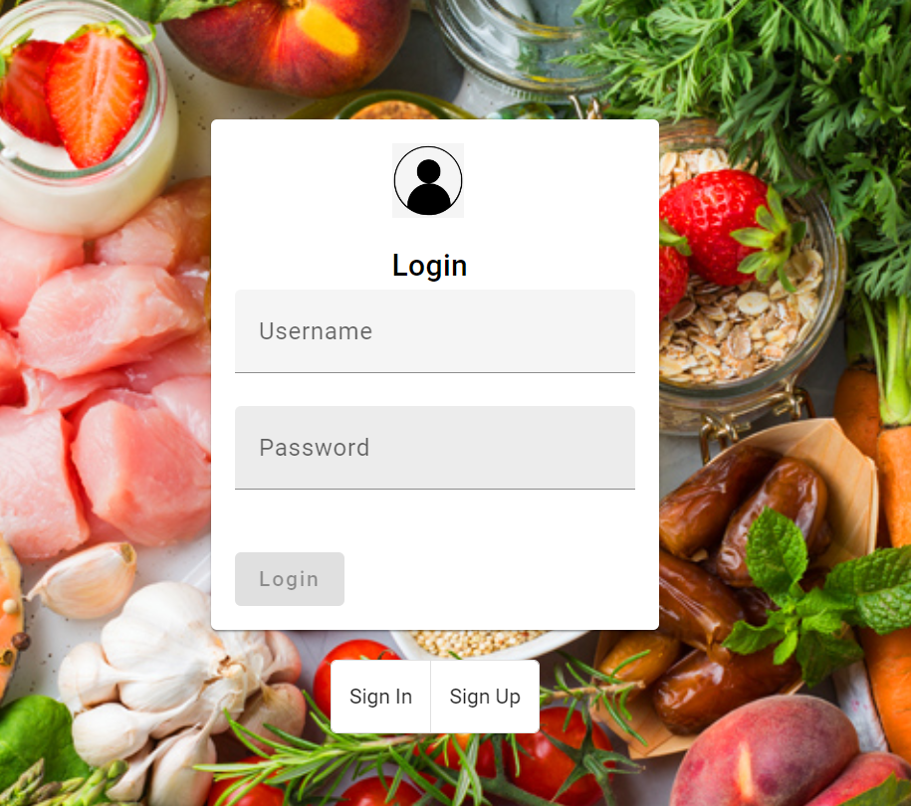
Nutrition diet
In the nutrition diet first started with the button which is like user and admin which is in the login-page component.
In this two button are there which is sign in and signup
Signup we can register

Slide 2
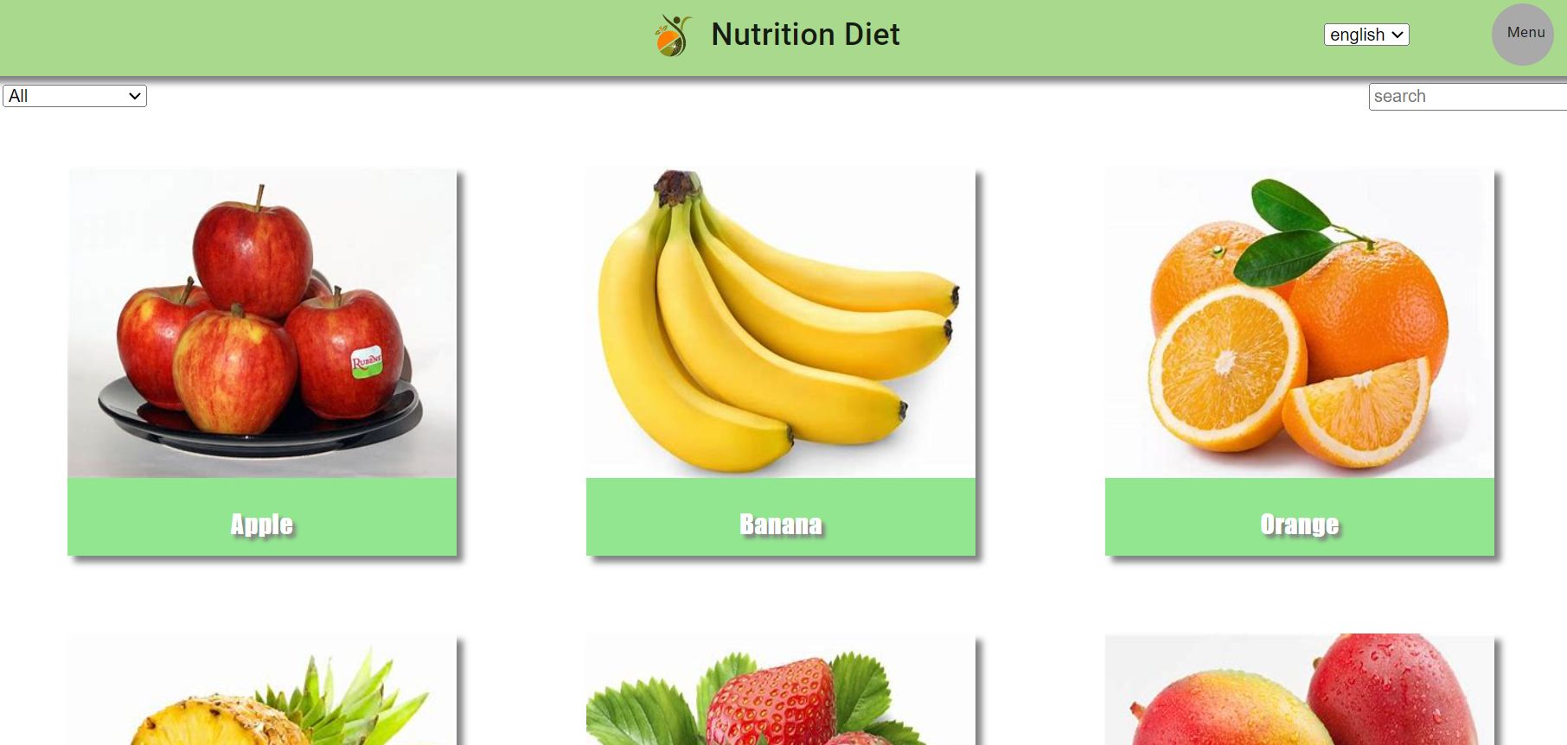
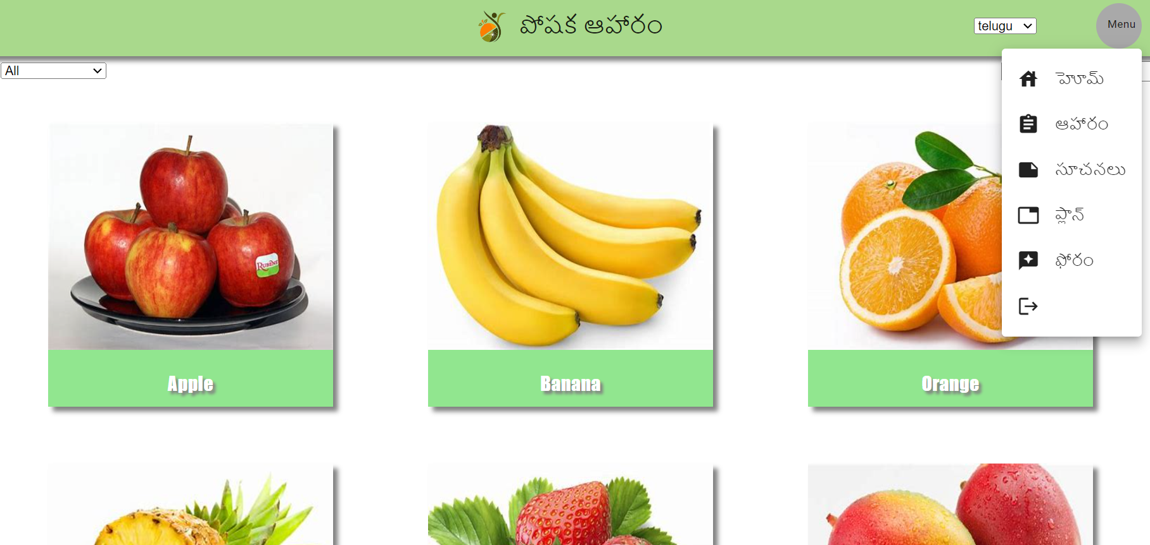
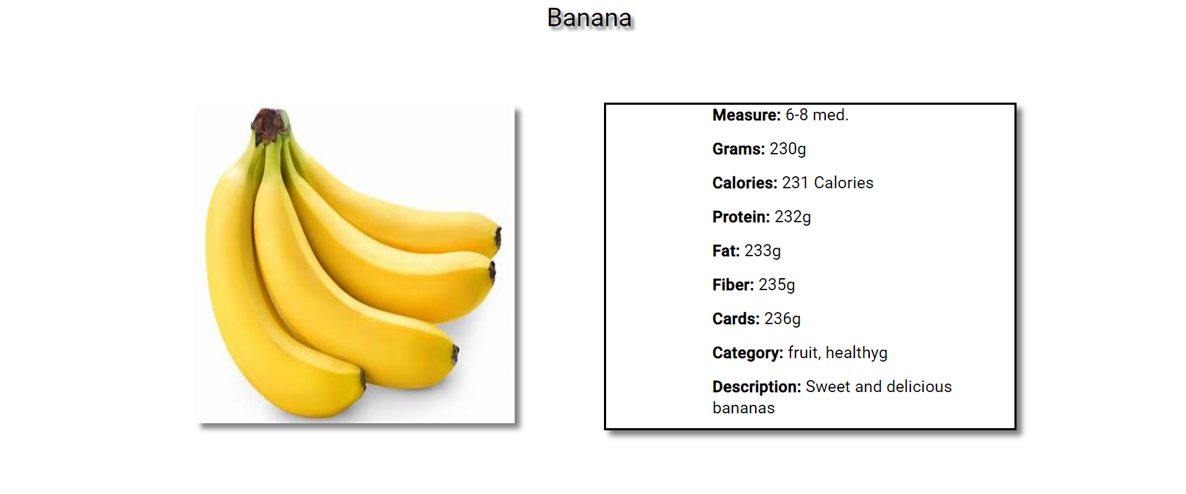
User page
In the user page they are home, diet,suggestions,plan,forum and at last logout the home page is like this
In the product for each items details are there.
We can search and we can filter
And in this I have added translate language
If I click any of the product it will display like this in the late page

Slide 3
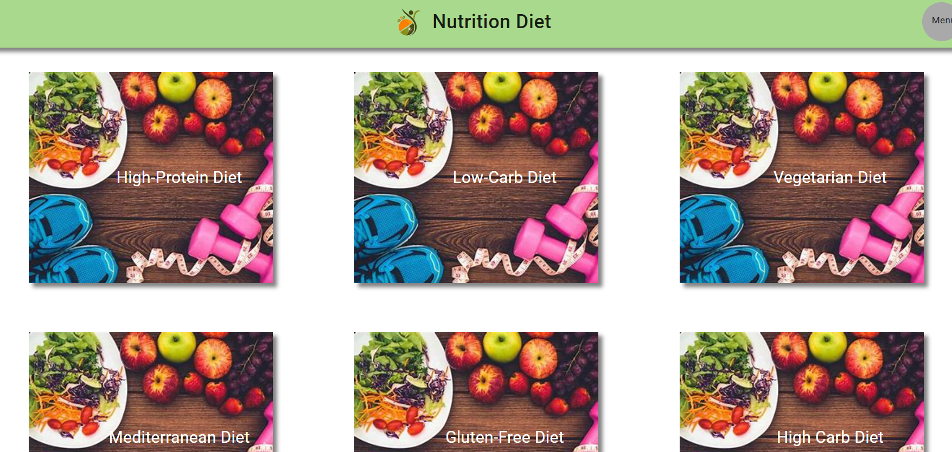
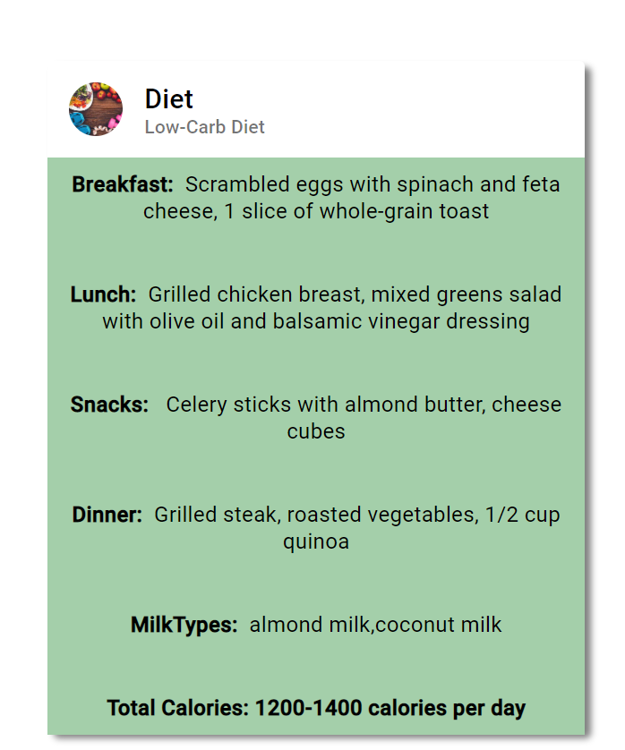
diet
Here it display the different diets plans
If u click the any diet plan it shows the details
If I click the any of the diet plan it will display the details like this

Slide 4
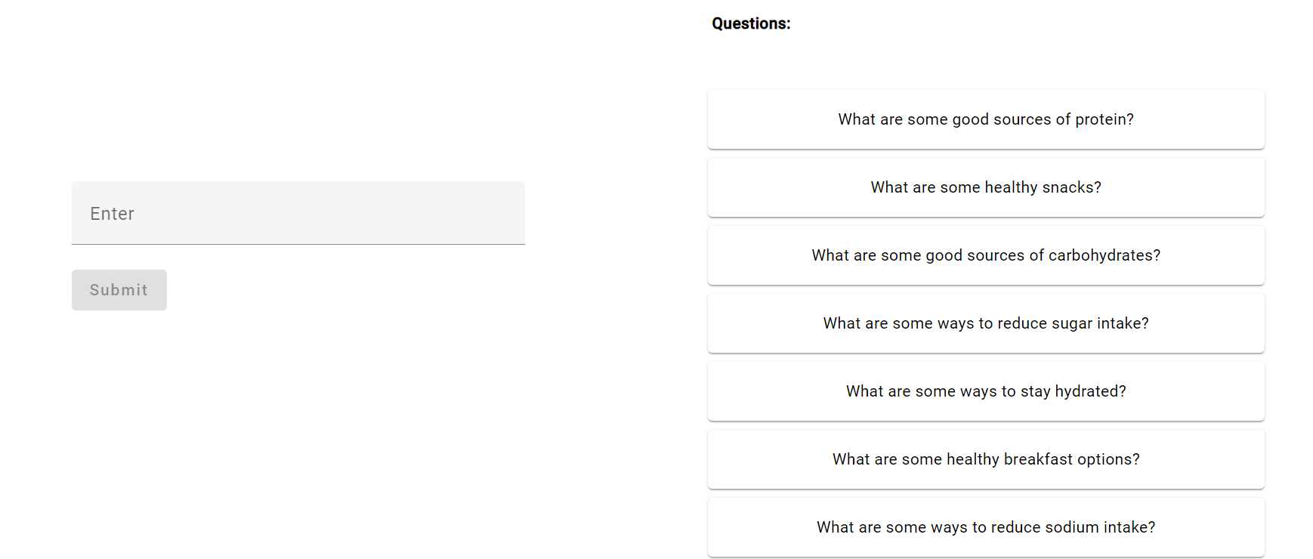
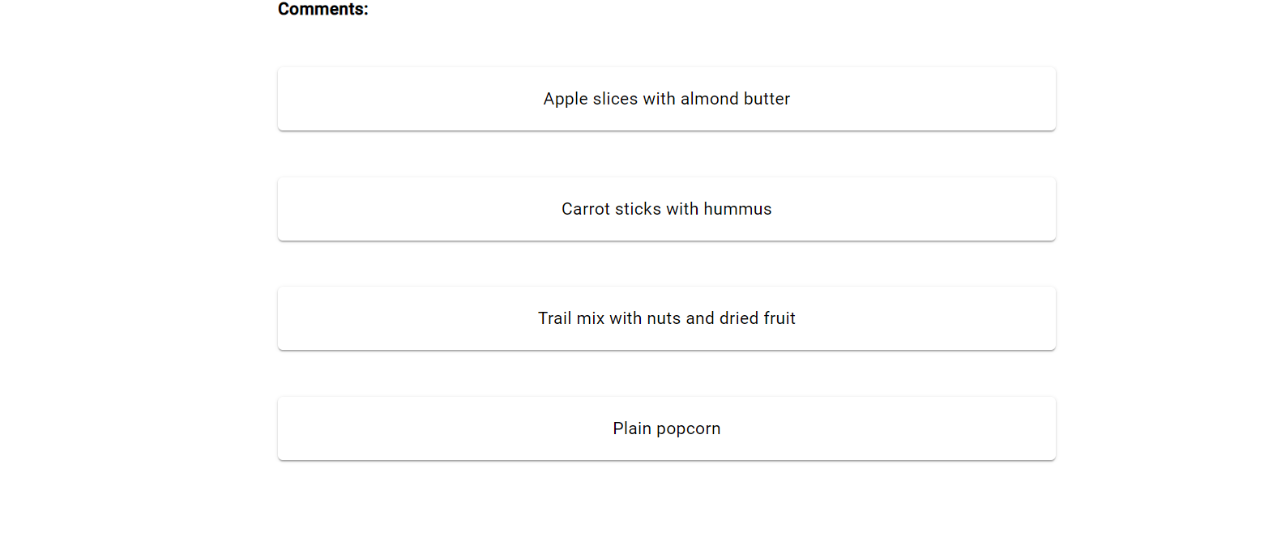
suggestions
In the suggestion page if a user given question the admin will give the responses and we can see the comments
If u click the any of the question will display the comments inside the question

Slide 5
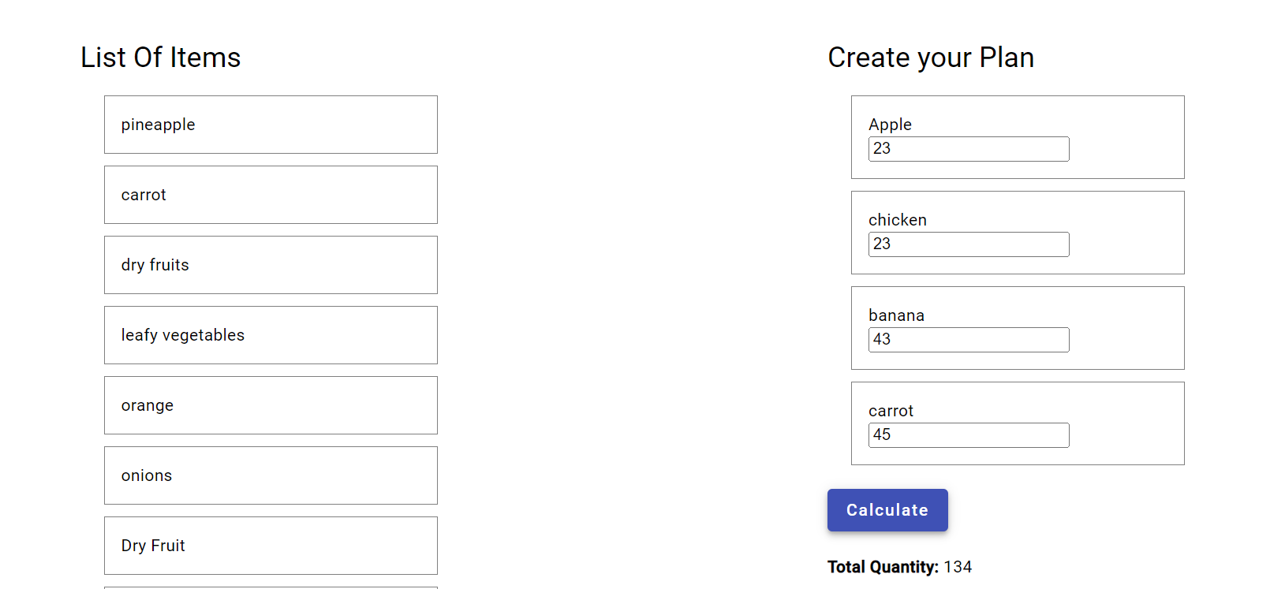
plan
In the plan we can create the plan and we can add the quantity at last if I click the button it will calculations
And also we can move the items to list of items and also the create your plan

Slide 6
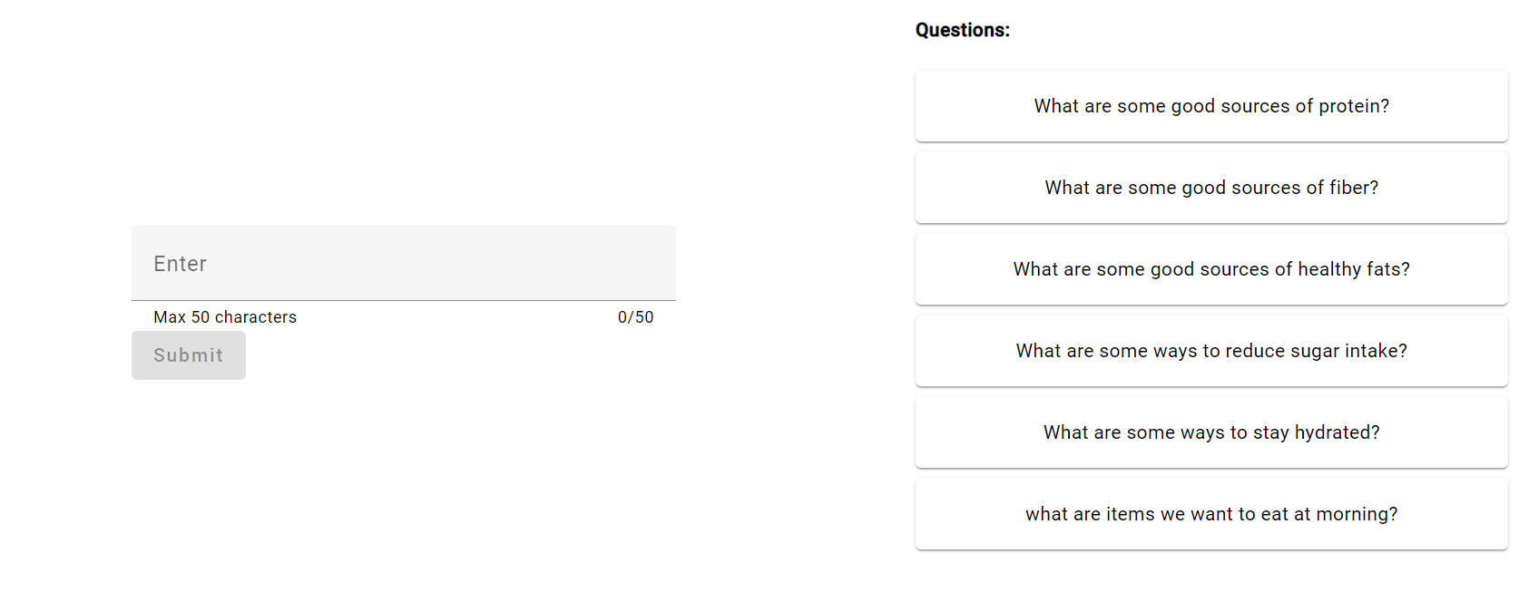
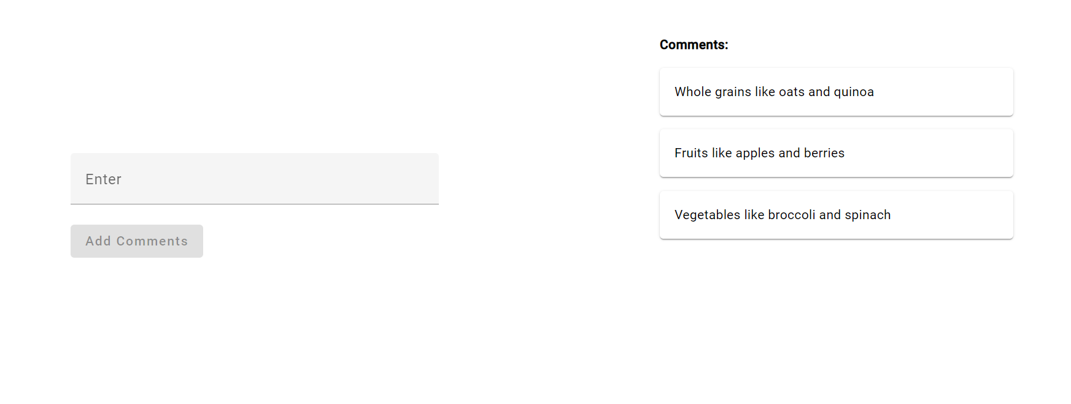
forum
In this forum both admin and user can access questions and comments
If want the user can post they queries and the admin can respond the query are the user can answer the question
In the type box I added validation

Slide 7
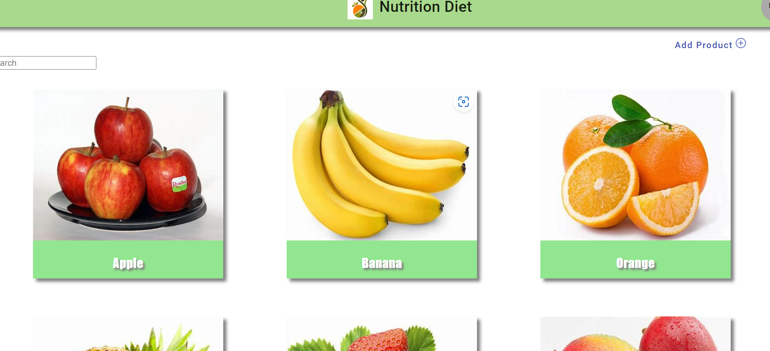
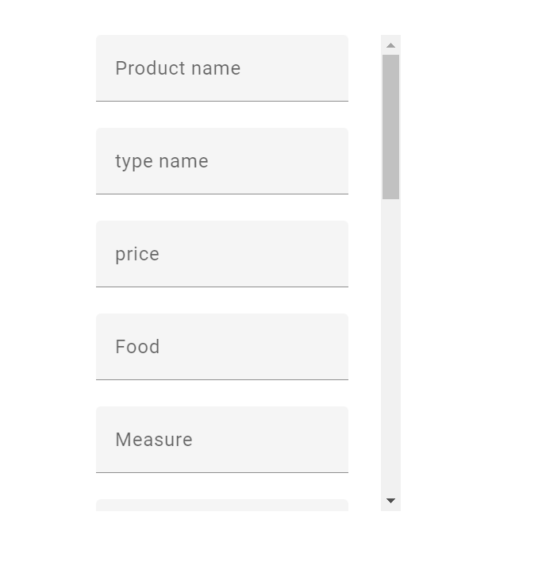
Admin
In the admin page the admin can add the product and responses
In the page the filter pipe is there and if I click the add product it open the new page , in that we can add the product and the give the proteins etc..

Slide 8
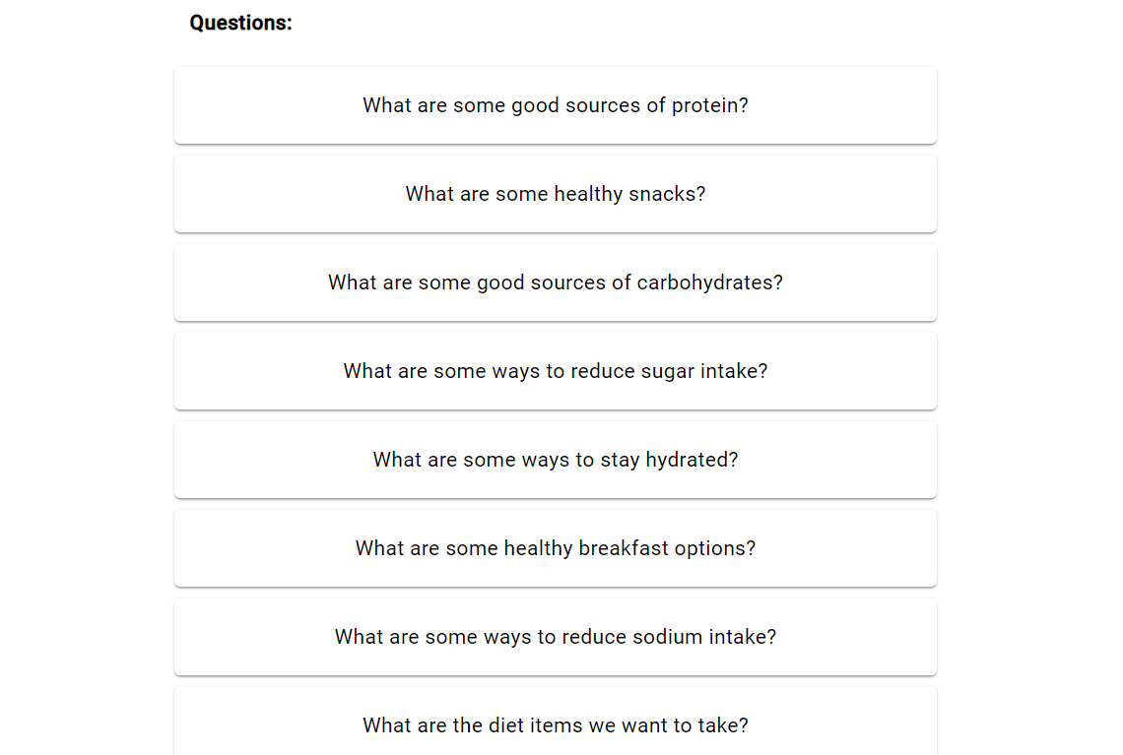
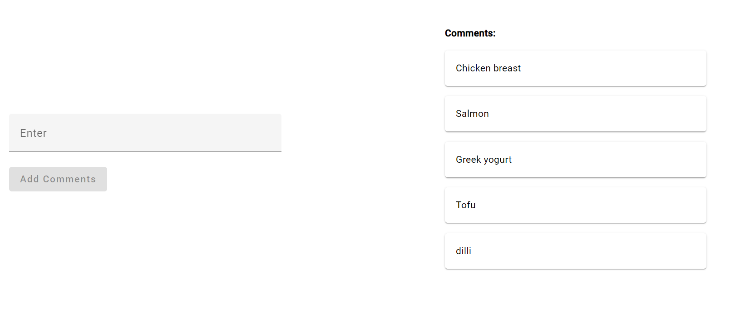
Add Responses
In the add responses page the admin can add the responses which is given by the user
If I can any of the question it will ask the comments for the question
In the comments section the multiple comments are display the admin can add the responses for each question

Slide 9
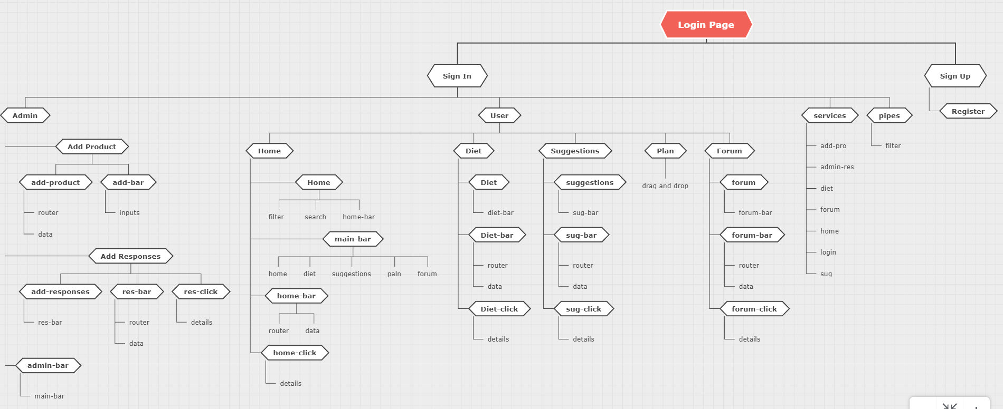
Flow Chart

